Slide 1
الكيمياء الحياتية1 1 Biochemistry

Slide 2
Chemistry of Carbohydrates
Objectives
This chapter is aiming to discuss the
carbohydrate constituents of human food.
It is designed to familiarize the student
with the biochemical classification of
carbohydrates.
The student will be informed with the
nutritional availability and importance of
various carbohydrate classes.

Slide 3
General characteristics
They are polyhydroxy aldehydes or ketones
Some time, they called (glycans)
They have the following basic composition:
(CH2O)n or H - C – OH
Compounds composed of C, H, and O
(CH2O)n when n = 5 then C5H10O5

Slide 4
General characteristics
Most abundant organic compounds in the
plant world
They are storehouses of energy
They serve as components of supportive
structures in plants (cellulose)
They are essential components of nucleic
acids (D-ribose (RNA) and 2-deoxy-Dribose
(DNA))

Slide 5
Classification of Carbohydrates
Monosacharides - simple sugars with
multiple OH groups. Based on number of
carbons (3, 4, 5, 6), a monosaccharide is a
triose, tetrose, pentose or hexose.
Disaccharides - 2 monosaccharides
covalently linked.
Oligosaccharides - a few monosaccharides
covalently linked.
Polysaccharides - polymers consisting of
chains of monosaccharide or disaccharide
units.

Slide 6
Classification of Carbohydrates
Monosaccharides:
– Glucose, Fructose & Galactose
Disaccharides:
–Maltose, Lactose & Sucrose
Polysaccharides:
– Starch & Glycogen

Slide 7
Monosaccharides: CnH2nOn
Also known as simple sugars
Classified by
1. the number of carbons
2. whether aldoses (aldehyde)
or ketoses (ketone)
Most (99%) are straight chain compounds

Slide 8
Monosaccharides:
All other sugars have the ending ose
(glucose, galactose, ribose, lactose, etc…)
The suffix -ose is added to a molecule that
is a carbohydrate, and prefixes tri-, tet-, and
pent- are used to indicate the number of
carbons
D-glyceraldehyde is the simplest of the
aldoses (aldotriose)
Pentoses and hexoses dominating

Slide 9
Monosaccharides: Sugar Nomenclature
3 carbon sugar – triose
4 carbon sugar – tetrose
5 carbon sugar – pentose
6 carbon sugar – hexose
7 carbon sugar – heptose
8 carbon sugar – octoses

Slide 10
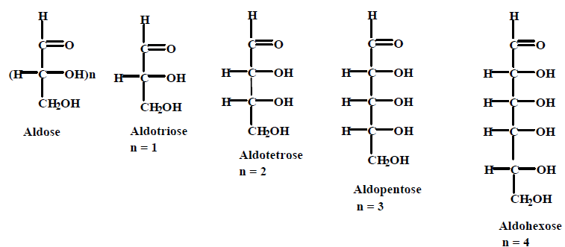
Aldose sugars
Where n is the number of asymmetric centers.

Slide 11
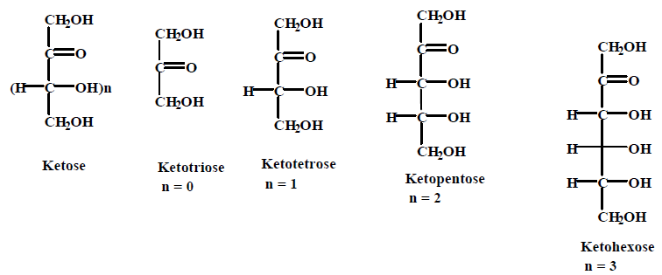
Ketose sugars
Where n is the number of asymmetric centers.

